Slide 1

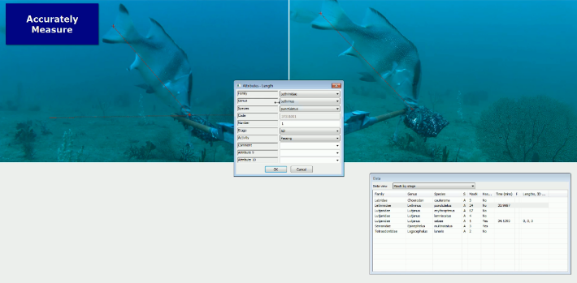

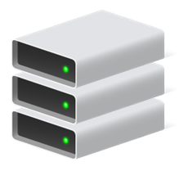






National/Institutional
portal/db
SyncTOOL
GlobalArchive
CheckEM
TPAC

Slide 2
